Slide 1
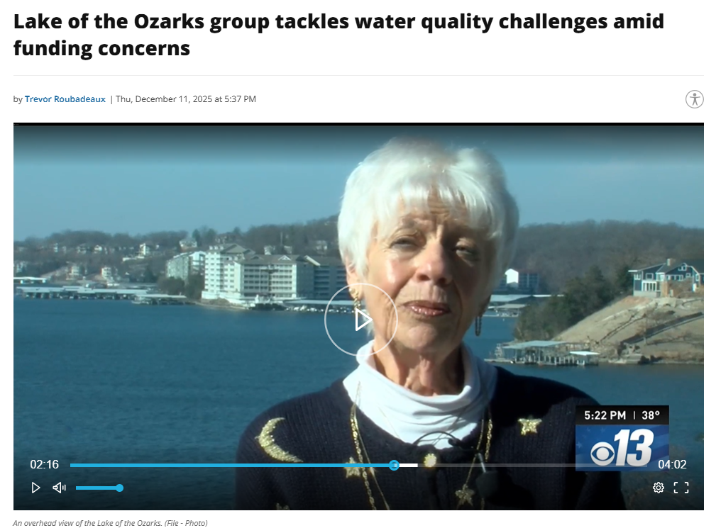
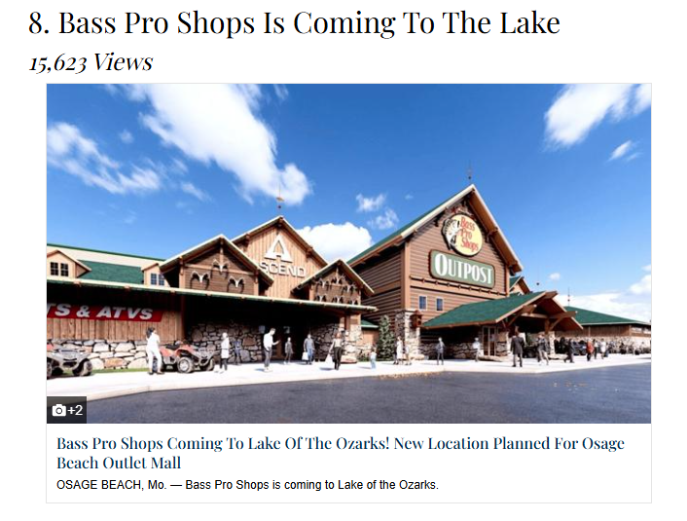
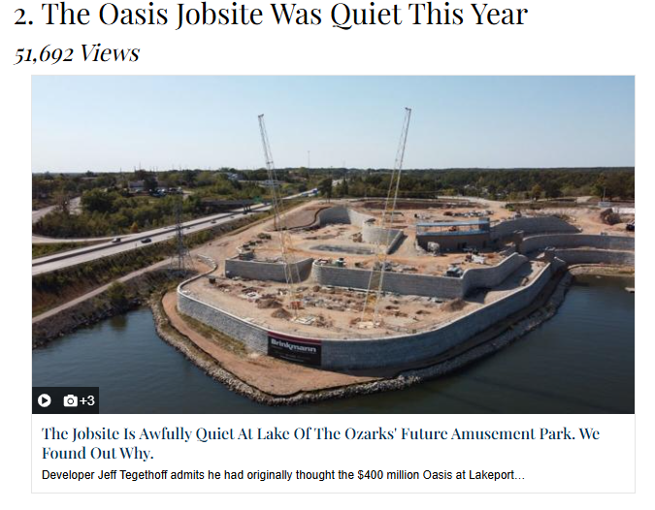
2025 Lake of the Ozarks Water Quality Report
June 23, 2026
LOWA Board Meeting

Slide 2
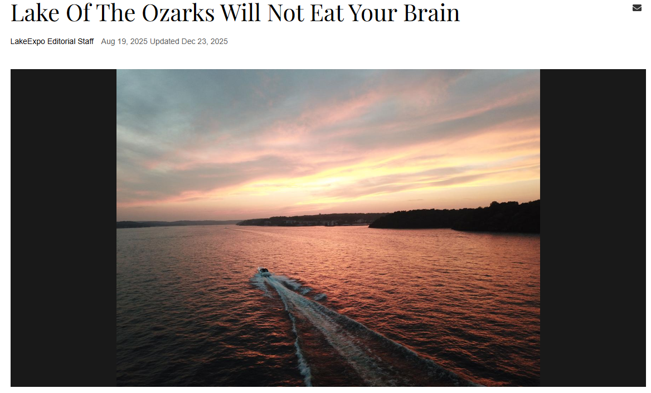
LOWA LOTO Agenda
Stratification
Numeric Nutrient Criteria
Water Quality Monitoring Program
  2025 Water Quality Results
  Historic Water Quality Data

Slide 3
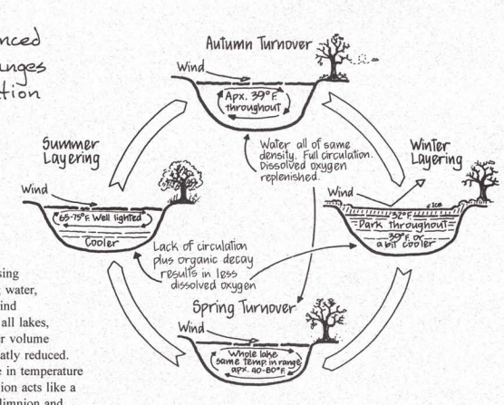
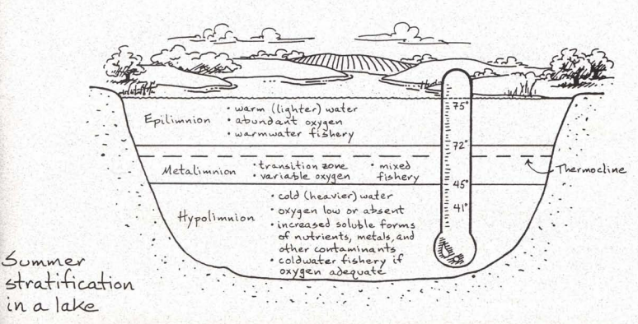
Lake Stratification and Mixing
Information: IEPA, Lake-Stratification (illinois.gov)
“IEPA most important factors of Lake mixing: Waves (wind/recreations) and Inflow/Outflow”

Slide 4
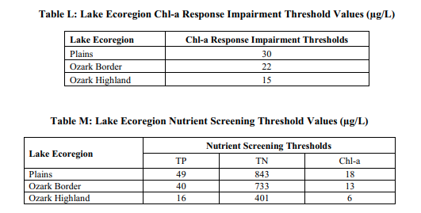
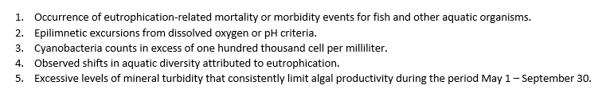
Numeric Lake Nutrient Criteria (May-Sept.)
USEPA approved on December 14, 2018
  Aquatic life protection…10 CSR 20-7.031
Measured at or near outflow of the Lake
Annual Geometric Means
Five Eutrophication Factors

Slide 5

LOWA Volunteer WQ Monitoring
Weekly (~22 events) during the summer season (May-September)
Locations
  Bagnell Dam (1 mm), Gravois (6 mm), Grand Glaize (18 mm), Niangua (30 mm), and Background (42 mm)
      Monitoring
    Total Nitrogen
    Total Phosphorus
    Chlorophyll-a
    Total Suspended Solids
    Secchi Depth (water clarity)

Slide 6
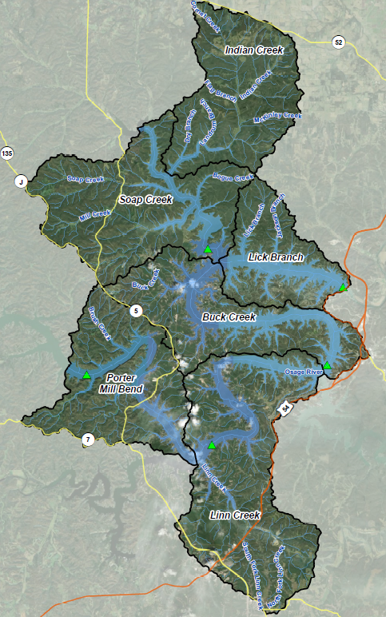
LOTO
WMP HUCS
  Lick Branch
  Buck Creek
  Indian Creek
  Soap Creek
  Linn Creek
  Porter Mill Bend

Slide 7
Factors Influencing Lake Water Quality
Watershed Uses (nutrients, temperature, sediment)
  Residential/Commercial
  Agriculture (Pasture/Row Crop)
  Waste Management
    Point Sources (NPDES)
    Non-point Sources (Septic)
Climate
  Temperature (warmer for longer)
  Waves wind/recreation
  Lake cycling (inflow/outflow)
  Sunlight
  When it rains
  How much it rains
  Rain intensity

Slide 8
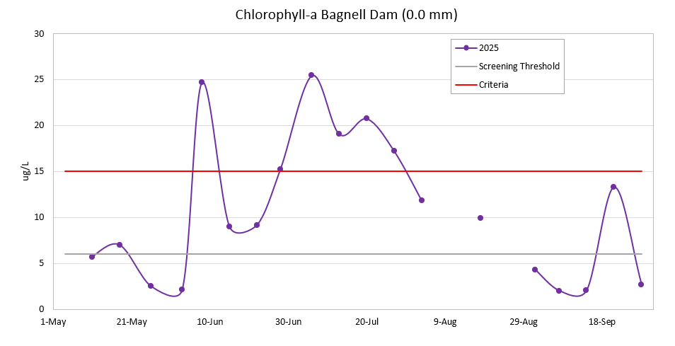
2025 Data Summary
Location | Chl-a ug/L | TSS mg/L | Total Nitrogen ug/L | Total Phosphorus ug/L | Secchi Depth (inches)
Background 42mm | 14.2 | 9.2 | 884 | 91 | 26
Grand Glaize 18mm | 5.8 | 4.6 | 717 | 45 | 39
Bagnell 0 mm | 7.8 | 5.0 | 727 | 40 | 57
SUMMARY:
-Chl-a, TN, TP exceed the MDNR screening thresholds
-TN and Chl-a increase from GG to Bagnell
Water clarity, TN, TP, Chl-a generally decrease moving downstream in the lake
-58 samples, >110 hours

Slide 9
LOWA Volunteer Water Quality Monitoring
2021 – 2025
  2021: 106 samples from 5 locations, >190 hours VT
  2022: 105 samples from 5 locations, >200 hours VT
  2023: 55 samples from 3 locations, >80 hours VT
  2024: 62 samples from 3 locations, >120 hours VT
  2025: 58 samples from 3 locations, >110 hours VT
~400 samples and ~ 700 hours VT
2026: 3 locations (Background, Grand Glaize, Bagnell Dam)

Slide 10
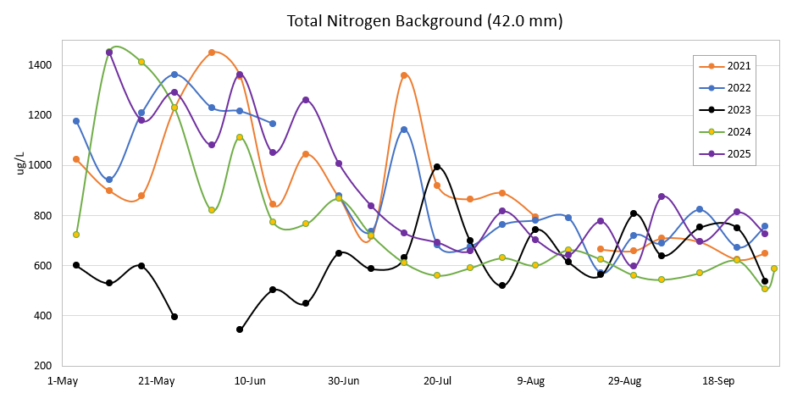
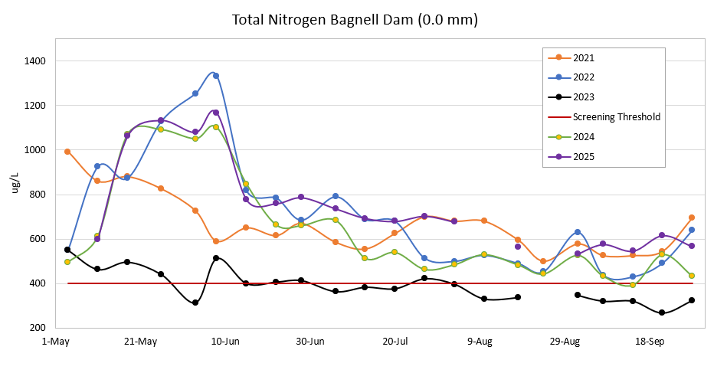
Historic Total Nitrogen (ug/L)
TN | 42 | 18 | 0
2021 | 883 | 855 | 653
2022 | 875 | 670 | 671
2023 | 598 | 406 | 383
2024 | 725 | 681 | 604
2025 | 884 | 717 | 727

Slide 11
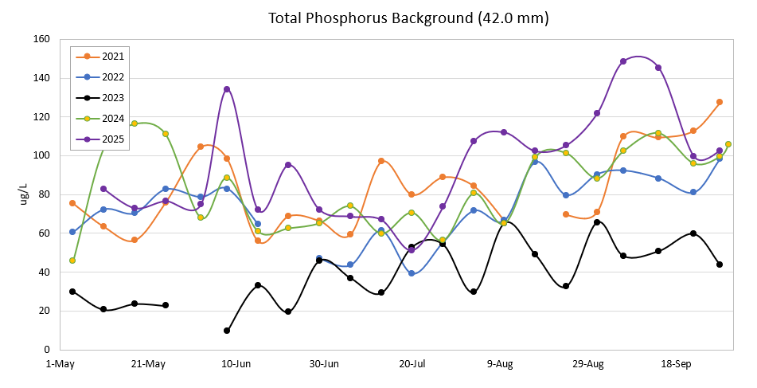
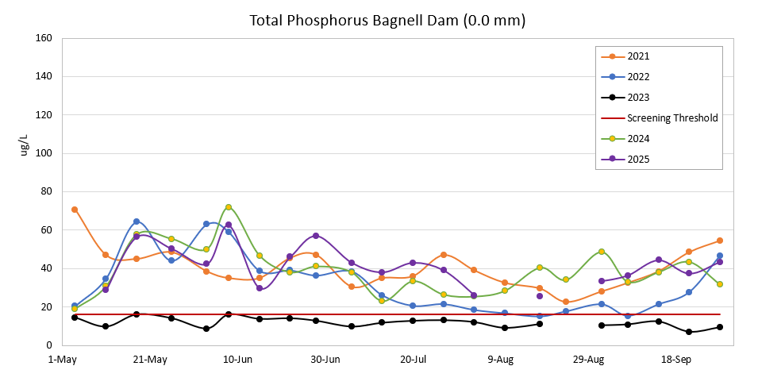
Total Phosphorus (ug/L)
TP | 42 | 18 | 0
2021 | 81 | 56 | 39
2022 | 70 | 36 | 29
2023 | 36 | 16 | 12
2024 | 81 | 47 | 37
2025 | 91 | 45 | 40

Slide 12
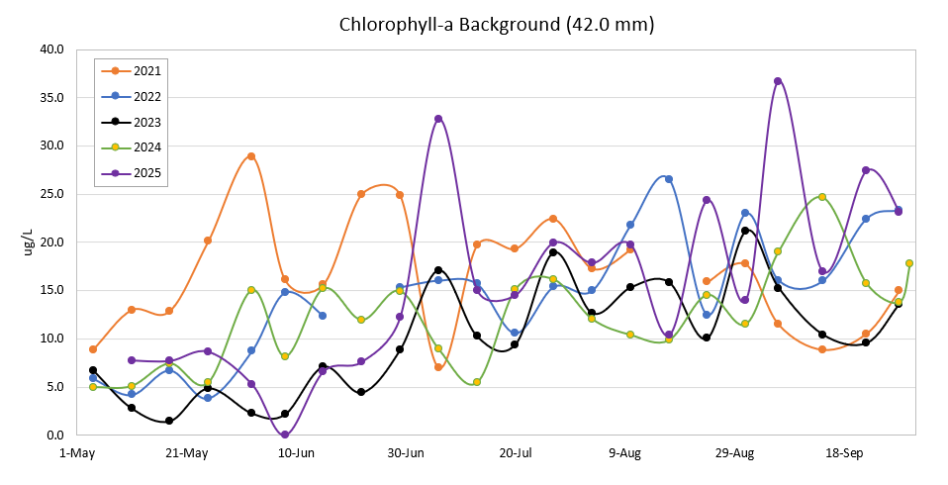
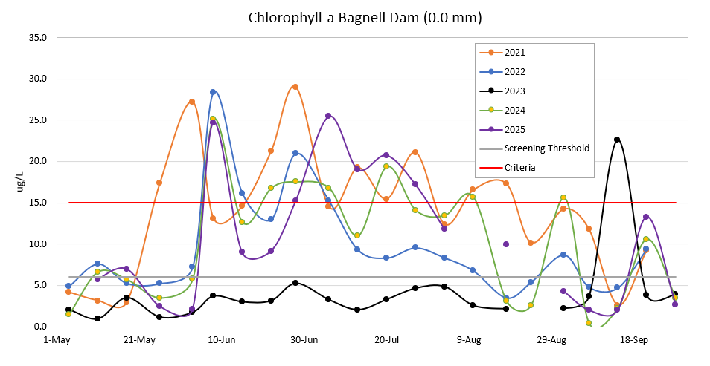
Chlorophyll-a (ug/L)
Chl-a | 42 | 18 | 0
2021 | 16 | 13 | 11
2022 | 13 | 7 | 8
2023 | 8 | 5 | 3
2024 | 11 | 6 | 7
2025 | 14 | 6 | 8

Slide 13
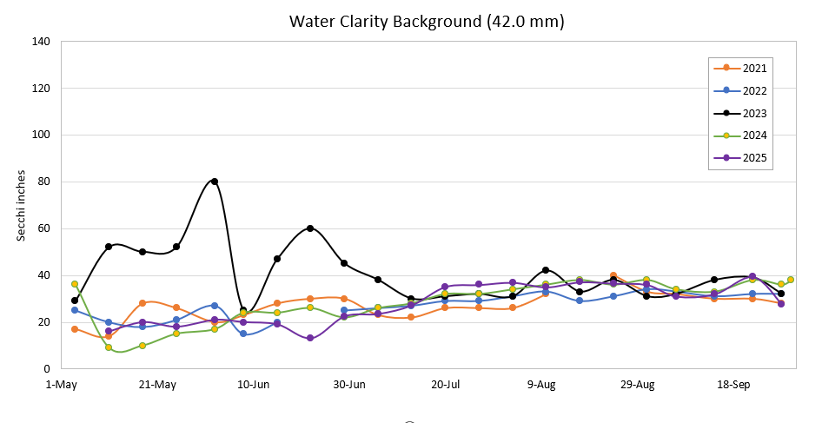
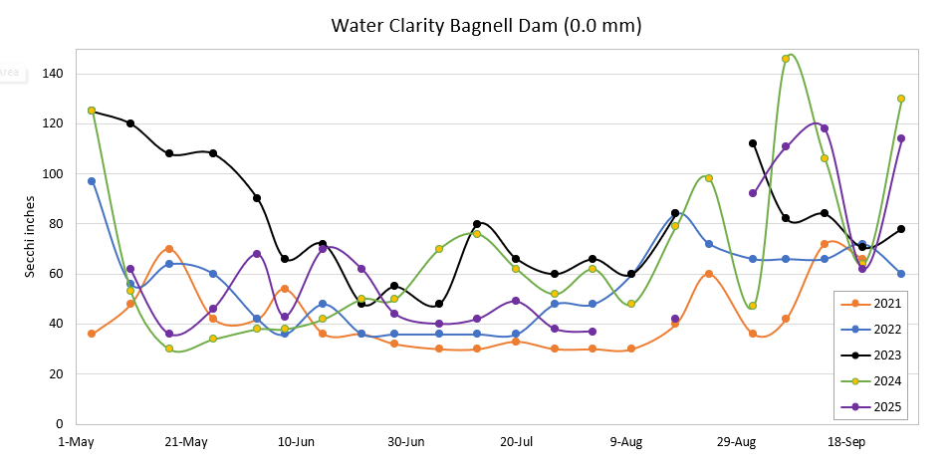
Water Clarity (inches)
Secchi | 42 | 18 | 0
2021 | 26 | 44 | 41
2022 | 27 | 40 | 54
2023 | 39 | 57 | 77
2024 | 27 | 40 | 62
2025 | 26 | 39 | 57

Slide 14
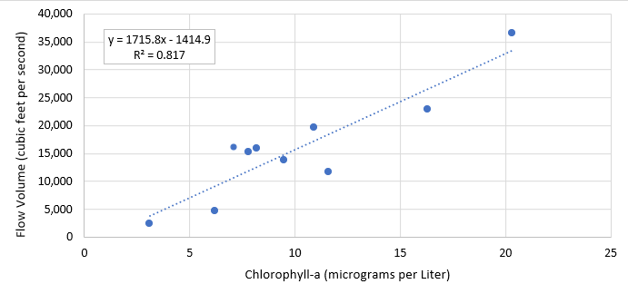
Bagnell Dam Chl-a/Outflow Relationship
Years (n=10) | Geometric Mean Chlorophyll-a (ug/L) | Average Bagnell Dam Outflow (cfs)
2016 | 12 | 11,652
2017 | 16 | 22,858
2018 | 6 | 4,681
2019 | 20 | 36,647
2020 | 10 | 13,880
2021* | 11 | 19,611
2022* | 8 | 15,941
2023* | 3 | 2,488
2024* | 7 | 16,132
2025* | 8 | 15,253
May-Sept: recreation season and LOTO has a relative constant water level

Slide 15
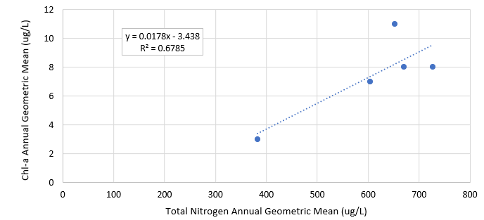
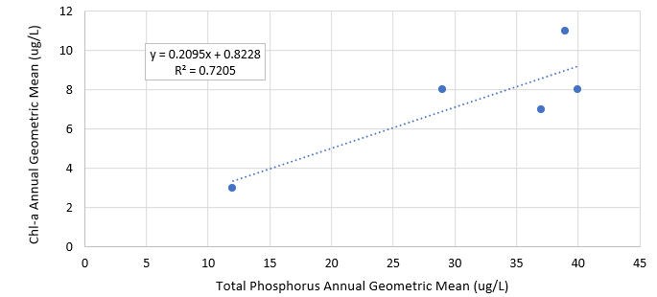
Bagnell Dam Chl-a and Nutrient Relationships

Slide 16
Summary
Nutrients are highest at Background 42 mm location (upstream Truman Reservoir only source)
  LOTO is acting as a nutrient sink
  TN, Chl-a variability 20mm to Bagnell Dam
Annual Variability (climate, lake cycling, and land use changes)
  Continued monitoring is important
    Potential 303(d) Delisting or Criteria Revision (Ozark Border or Plains ecoregions)

